Slide 1
Advanced Database Management Systems (CSC-234)
MongoDB Array Operations

Slide 2
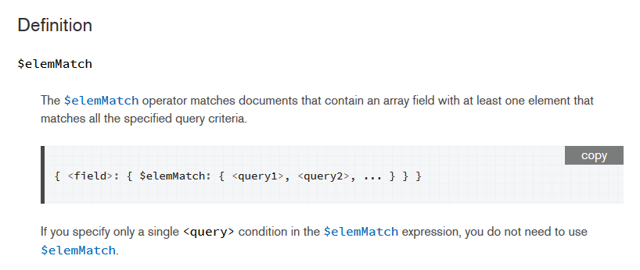

Slide 3
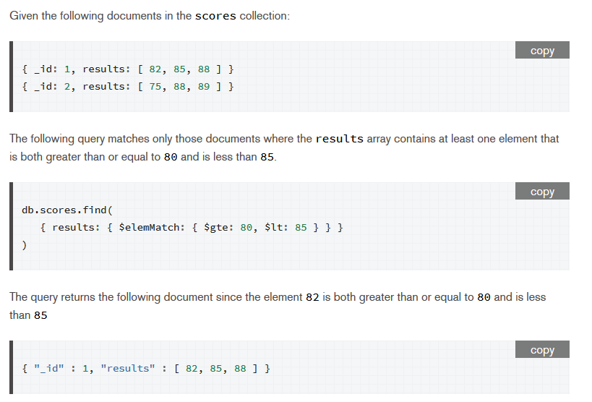

Slide 4
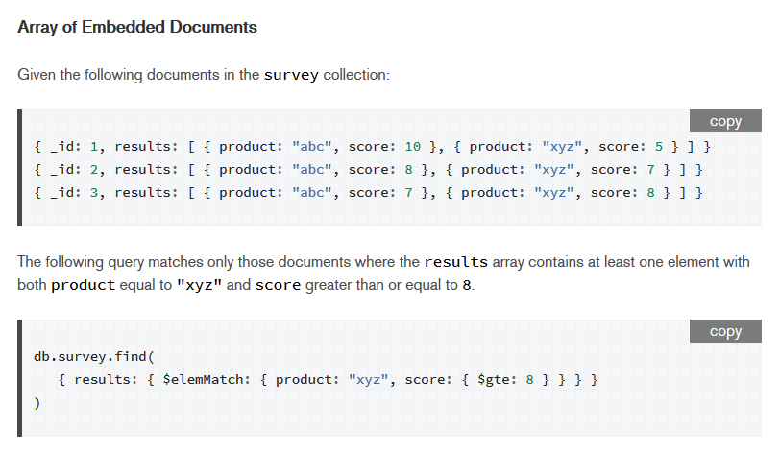

Slide 5
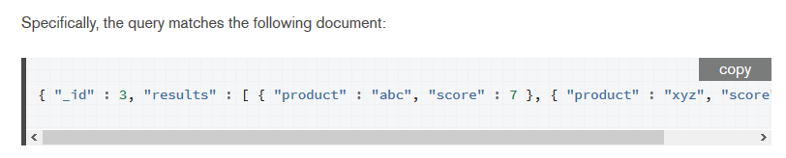

Slide 6
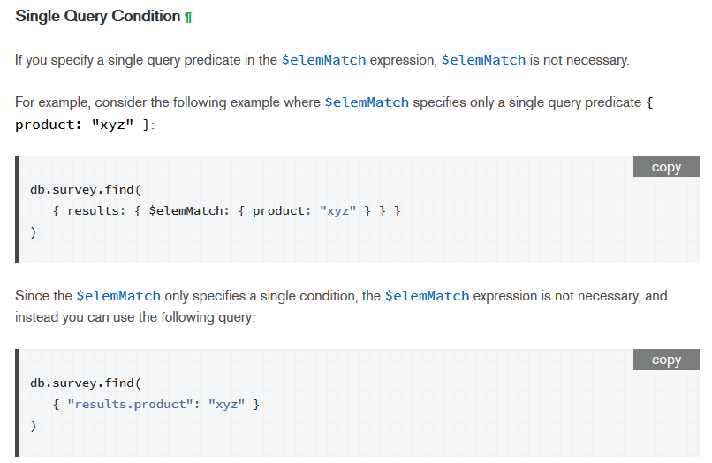

Slide 7

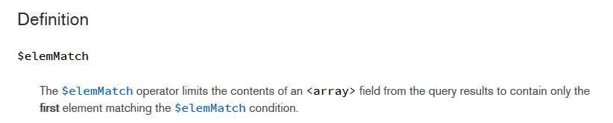

Slide 8
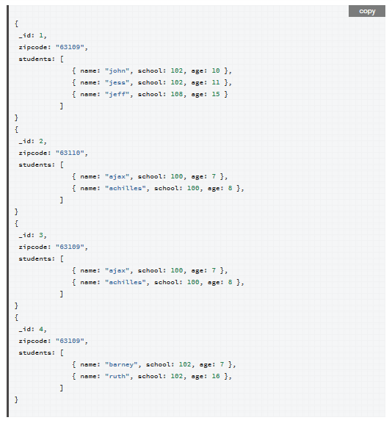
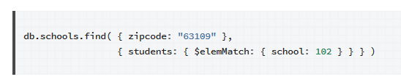

Slide 9
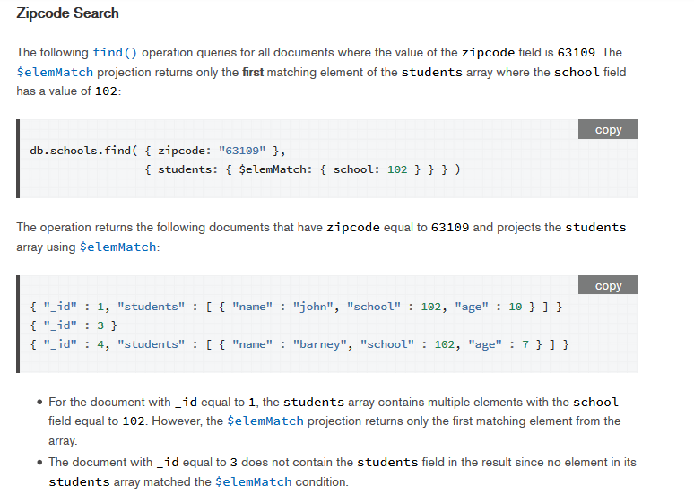

Slide 10
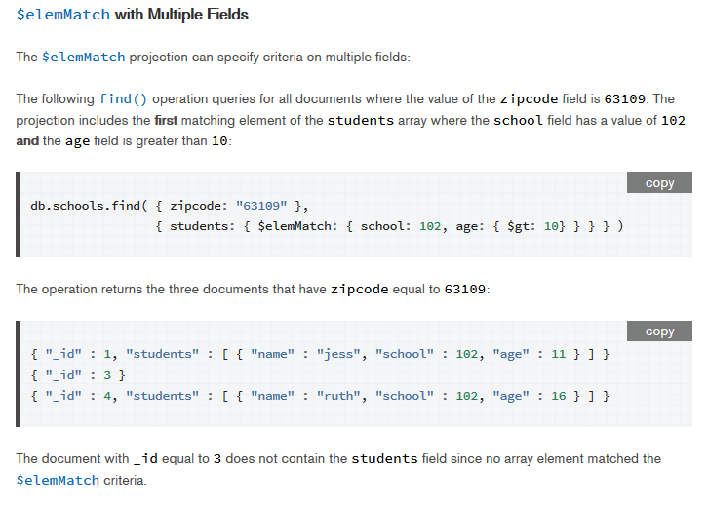

Slide 11
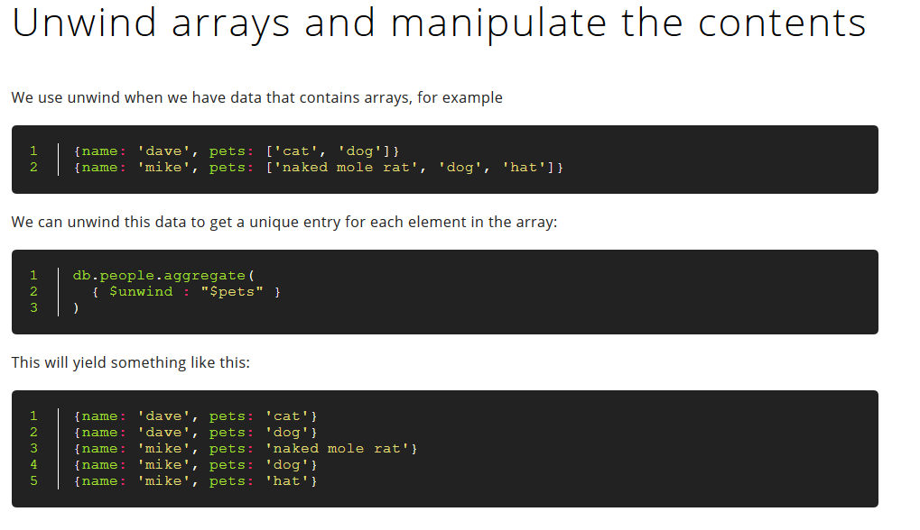

Slide 12
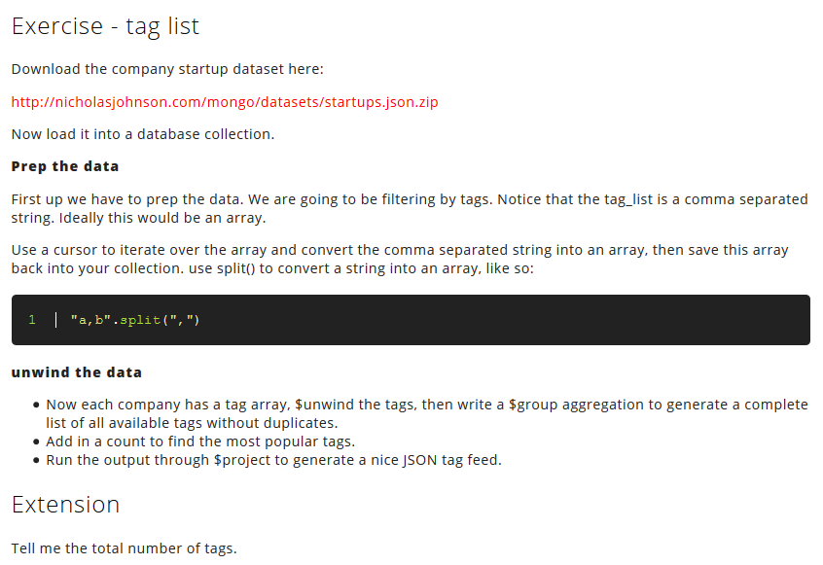

Slide 13
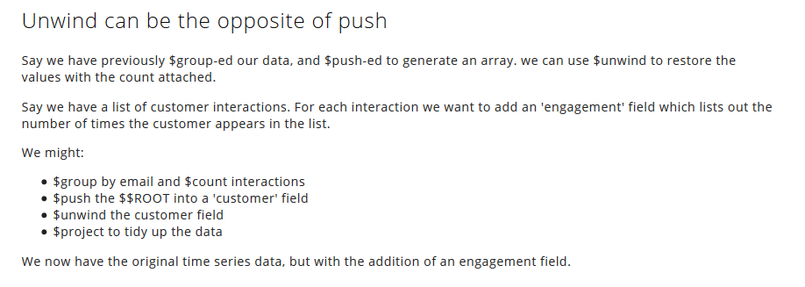

Slide 14
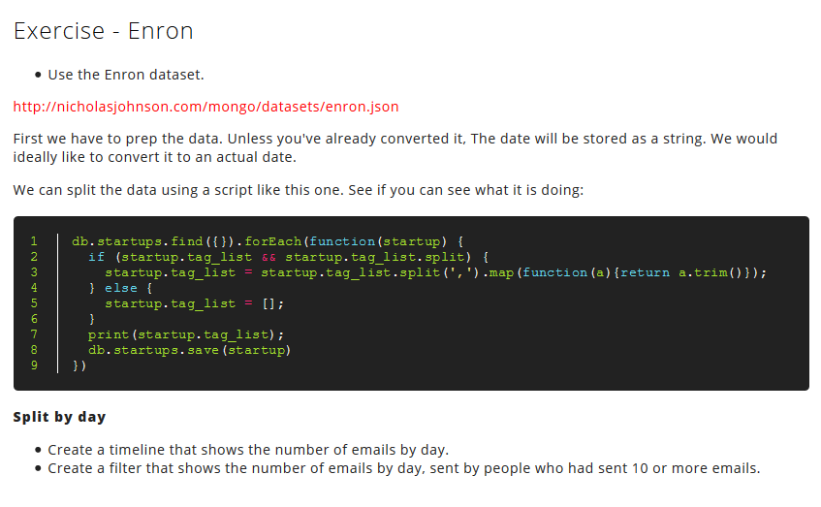

Slide 15
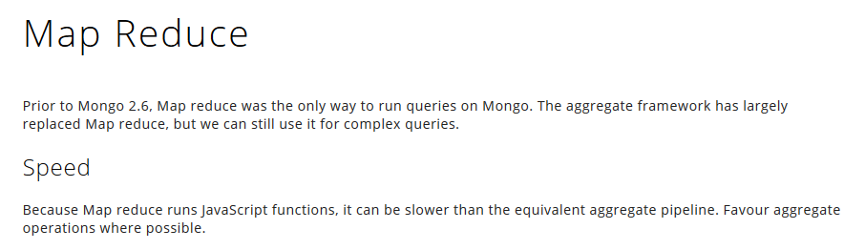

Slide 16
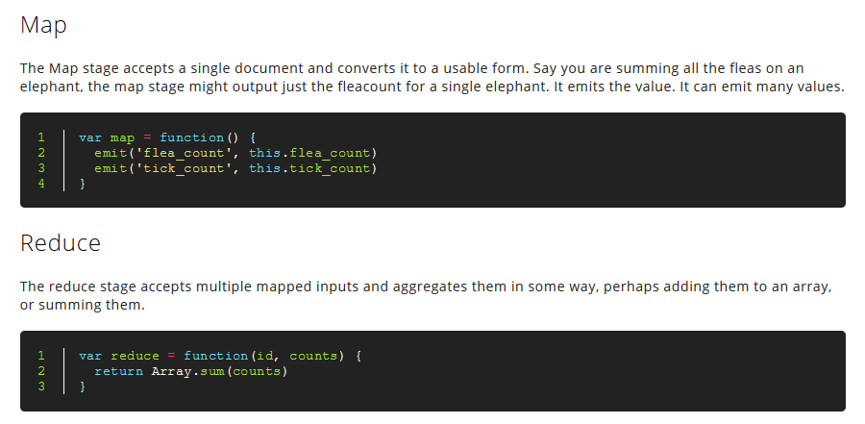

Slide 17
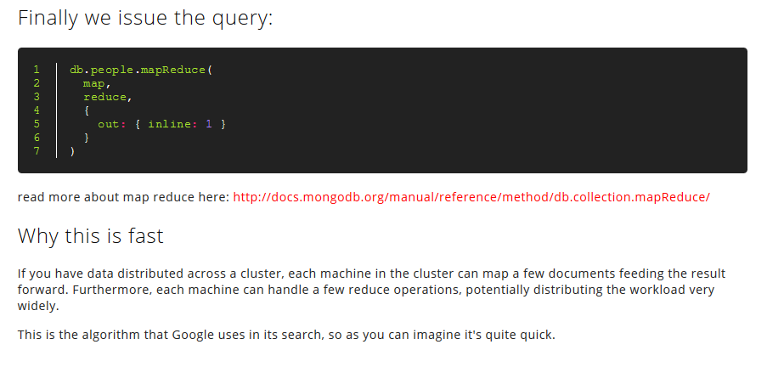

Slide 18
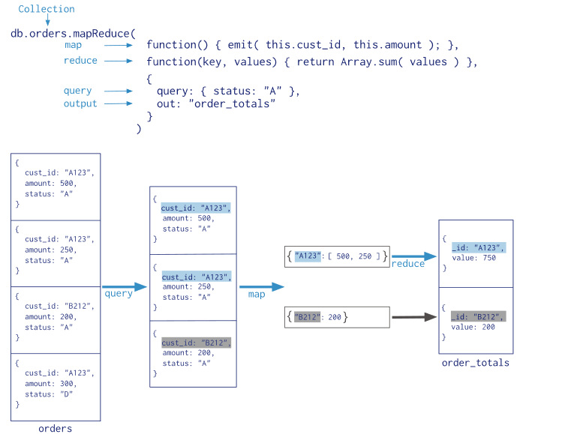

Slide 19
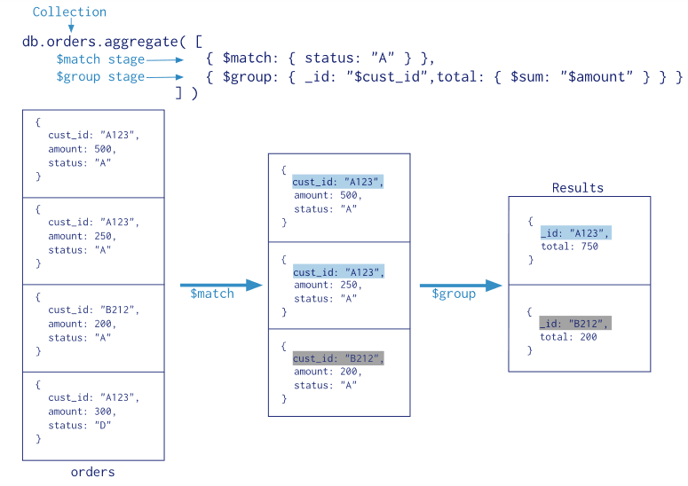
Data Aggregation Pipeline

Slide 20
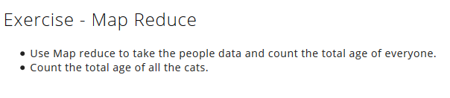

Slide 21
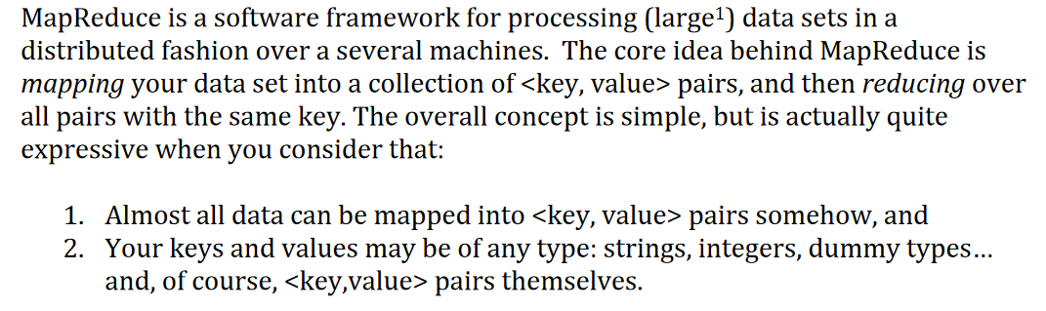
MapReduce

Slide 22
MapReduce
Name derived from proprietary Google technology

Slide 23
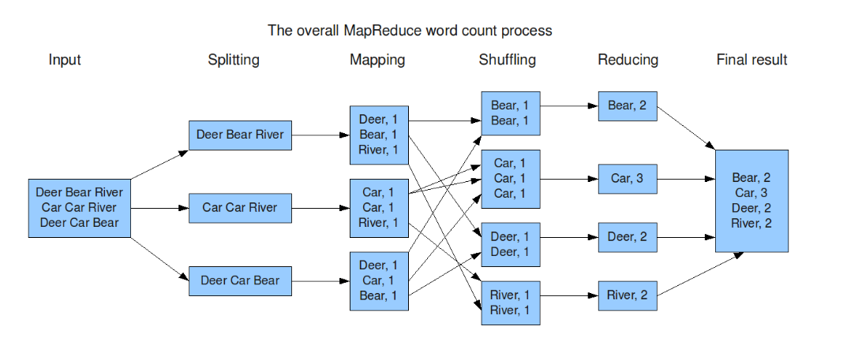
Canonical Word Count Problem

Slide 24
Lecture content adapted from
https://docs.mongodb.com/manual/ https://docs.mongodb.com/manual/reference/operator/aggregation/group/
https://docs.mongodb.com/manual/reference/operator/query/elemMatch/
http://nicholasjohnson.com/mongo/course/workbook/

